Slide 1

Unit-4 Classification
Data Mining (DM)
2101CS521
Prof. Jayesh D. vagadiya
Computer Engineering Department
jayesh.vagadiya@darshan.ac.in
9537133260

Slide 2

Looping
Topics to be covered
Basic Concepts
Decision Tree Induction
Bayes Classification Methods
Rule-Based Classification
Model Evaluation and Selection

Slide 3
What Kinds of Patterns Can Be Mined?
Data mining functionalities can be classified into two categories:
Descriptive
Predictive
Descriptive
This task presents the general properties of data stored in a database.
The descriptive tasks are used to find out patterns in data.
E.g.: Frequent patterns, association, correlation etc.
Predictive
These tasks predict the value of one attribute on the basis of values of other attributes.
E.g.: Festival Customer/Product Sell prediction at store
We are going to cover this part in this chapter

Slide 4
Classification
One method of data analysis uses a model derived from previously collected data to predict a class label for fresh data.
Such model is known as classifiers to predict categorical (discrete, unordered) class labels.
Example:
we can build a classification model to categorize bank loan applications as either safe or risky.
The goal of classification is to learn a model that can automatically determine the appropriate class for new, unseen data based on patterns it has learned from a labeled training dataset.

Slide 5
Model
Model
Classifier
Predictor
This is known as classification Analysis
This is known as Regression Analysis
It is used for predication of class (categorical) label
It is used for predication of numeric prediction(continuous-valued function ).
Such as “safe” or “risky” for the loan application data; “yes” or “no” for the marketing data;
“treatment A,” “treatment B,” or “treatment C” for the medical data.
Suppose that the marketing manager wants to predict how much a given customer will spend during a sale at AllElectronics.

Slide 6
Steps in Classification
Classification is two step process.
First Step:
We build a classification model based on previous data.
Classification algorithm builds the classifier by analyzing or “learning from” a training set made up of database tuples and their associated class labels.
First step also know as learning step (or training phase)
Second Step:
We use the model to classify new data.
Second step also know as classification step.

Slide 7
Example
Name | Age | income | loan_decision
Sandy Jones | youth | low | risky
Bill Lee | youth | low | risky
Caroline Fox | middle_aged | high | safe
Rick Field | middle_aged | low | risky
Susan Lake | senior | low | safe
Claire Phips | senior | medium | safe
Joe Smith | middle_aged | high | safe
Juan Bello | senior | low | safe
Sylvia Crest | middle_aged | low | risky
Anne Yee | middle_aged | high | safe
Class Label
Tanning Data Set
Testing Data Set
Class Label is provided in so this learning is known as supervised machine learning

Slide 8
Example
Step - 1
Classification
Algorithms
Training
Data
Classifier
(Model)
Name | Age | income | loan_decision
Sandy Jones | youth | low | risky
Bill Lee | youth | low | risky
Caroline Fox | middle_aged | high | safe
Rick Field | middle_aged | low | risky
Susan Lake | senior | low | safe
Claire Phips | senior | medium | safe
Joe Smith | middle_aged | high | safe
IF age = youth THEN loan_decision = risky;
IF income = high THEN loan_decision = safe;
IF age = middle_aged AND income = low THEN
loan_decision = risky;

Slide 9
Example
Step - 2
Classifier
(Model)
Unseen Data
Testing
Data
(XYZ, youth, low)
loan_decision ?
Name | Age | income | loan_decision
Juan Bello | senior | low | safe
Sylvia Crest | middle_aged | low | risky
Anne Yee | middle_aged | high | safe
Risky
9

Slide 10
Decision Tree Induction
Decision tree induction is the learning of decision trees from class-labeled training tuples.
A decision tree is a flowchart-like tree structure.
The Inner node represents an attribute.
An Edge represents a test on attribute.
Leaf represent one of the classes.
A decision tree for the concept buys computer, indicating whether an AllElectronics customer is likely to purchase a computer.
age?
youth
senior
middle_aged
student?
Yes
credit_rating?
no
yes
fair
excellent
No
yes
No
Yes

Slide 11
History of Decision Tree
During the late 1970s and early 1980s, J. Ross Quinlan, a researcher in machine learning, developed a decision tree algorithm known as ID3 (Iterative Dichotomiser).
This work expanded on earlier work on concept learning systems, described by E. B. Hunt, J. Marin, and P. T. Stone. Quinlan later presented C4.5 (a successor of ID3).
In 1984, a group of statisticians (L. Breiman, J. Friedman, R. Olshen, and C. Stone) published the book Classification and Regression Trees (CART), which described the generation of binary decision trees.
ID3, C4.5, and CART adopt a greedy (i.e., non-backtracking) approach in which decision trees are constructed in a top-down recursive divide-and-conquer manner.

Slide 12
Decision Tree Induction Algorithm
Basic algorithm (a greedy algorithm):
Tree is constructed in a top-down recursive divide-and-conquer manner
At start, all the training examples are at the root
Attributes are categorical (if continuous-valued, they are discretized in advance)
Examples are partitioned recursively based on selected attributes
Test attributes are selected on the basis of a heuristic or statistical measure (e.g., information gain)
Conditions for stopping partitioning:
All samples for a given node belong to the same class
There are no remaining attributes for further partitioning – majority voting is employed for classifying the leaf
There are no samples left

Slide 13
Decision Tree Induction Algorithm
INPUT:
Data partition, D, which is a set of training tuples and their associated class labels;
Attribute list, the set of candidate attributes;
Attribute selection method, a procedure to determine the splitting criterion that “best” partitions the data tuples into individual classes. This criterion consists of a splitting attribute and, possibly, either a split-point or splitting subset.
Output:
A decision tree.

Slide 14
Decision Tree Induction Algorithm
create a node N ; if tuples in D are all of the same class, C, then
return N as a leaf node labeled with the class C; terminate;
if attribute list is empty then
return N as a leaf node labeled with the majority class in D; terminate; // majority voting
Apply Attribute_selection_method(D, attribute list) to find A with highest Attribute selection measure and Label node N with A
if A is discrete-valued and multiway splits allowed then // not restricted to binary trees
attribute list ← attribute list − A;
For each value v of A:
// partition the tuples and grow subtrees for each partition
let D_{j} be the set of data tuples in D with V=D_{j};
if D_{j} is Empty then
attach a leaf labeled with the majority class in D to node N;
else
attach the node returned by Generate_decision_tree(D_{j}, attribute list) to node N;
End for
Return N;

Slide 15
Attribute Selection Measures
Attribute selection measures are known as splitting rules because they determine how the tuples at a given node are to be split.
An attribute selection measure is a heuristic for selecting the splitting criterion that “best” separates a given data partition, D, of class-labeled training tuples into individual classes.
The tree node created for partition D is labeled with the splitting criterion, branches are grown for each outcome of the criterion, and the tuples are partitioned accordingly.
Three popular attribute selection measures
Information gain
Gain ratio
Gini index

Slide 16
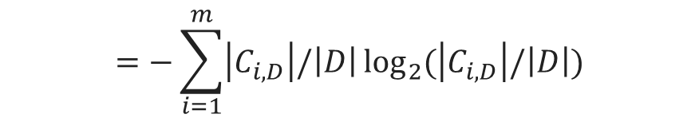
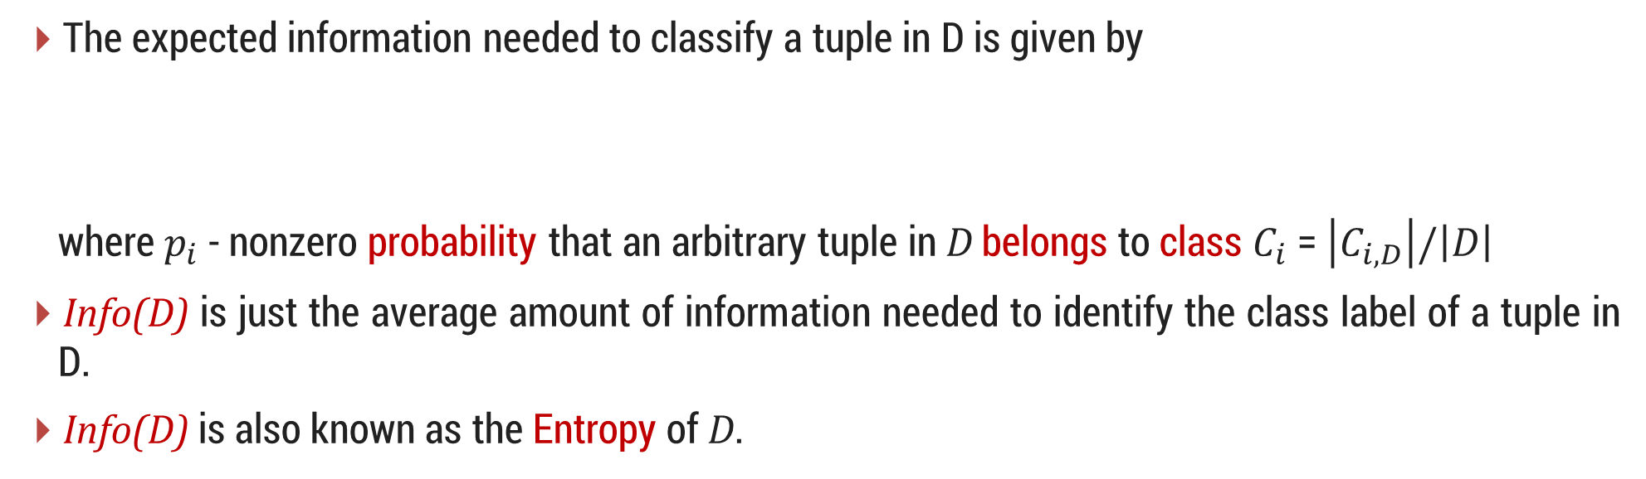
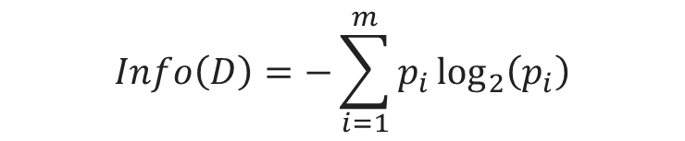
1. Information Gain
ID3 uses information gain as its attribute selection measure.
Let node N represent or hold the tuples of partition D. The attribute with the highest information gain is chosen as the splitting attribute for node N.
This attribute minimizes the information needed to classify the tuples in the resulting partitions and reflects the least randomness or “impurity” in these partitions.
The expected information needed to classify a tuple in D is given by
where $p_{i}$ - nonzero probability that an arbitrary tuple in D belongs to class $C_{i}$ = $\left|C_{i,D}\right|/\left|D\right|$
Info(D) is just the average amount of information needed to identify the class label of a tuple in D.
Info(D) is also known as the Entropy of D.
$$Info\left(D\right)=−\sum_{i=1}^{m}{p_{i}\log_{2}\left(p_{i}\right)}$$
$$=−\sum_{i=1}^{m}{\left|C_{i,D}\right|/\left|D\right|\log_{2}{(\left|C_{i,D}\right|/\left|D\right|)}}$$

Slide 17
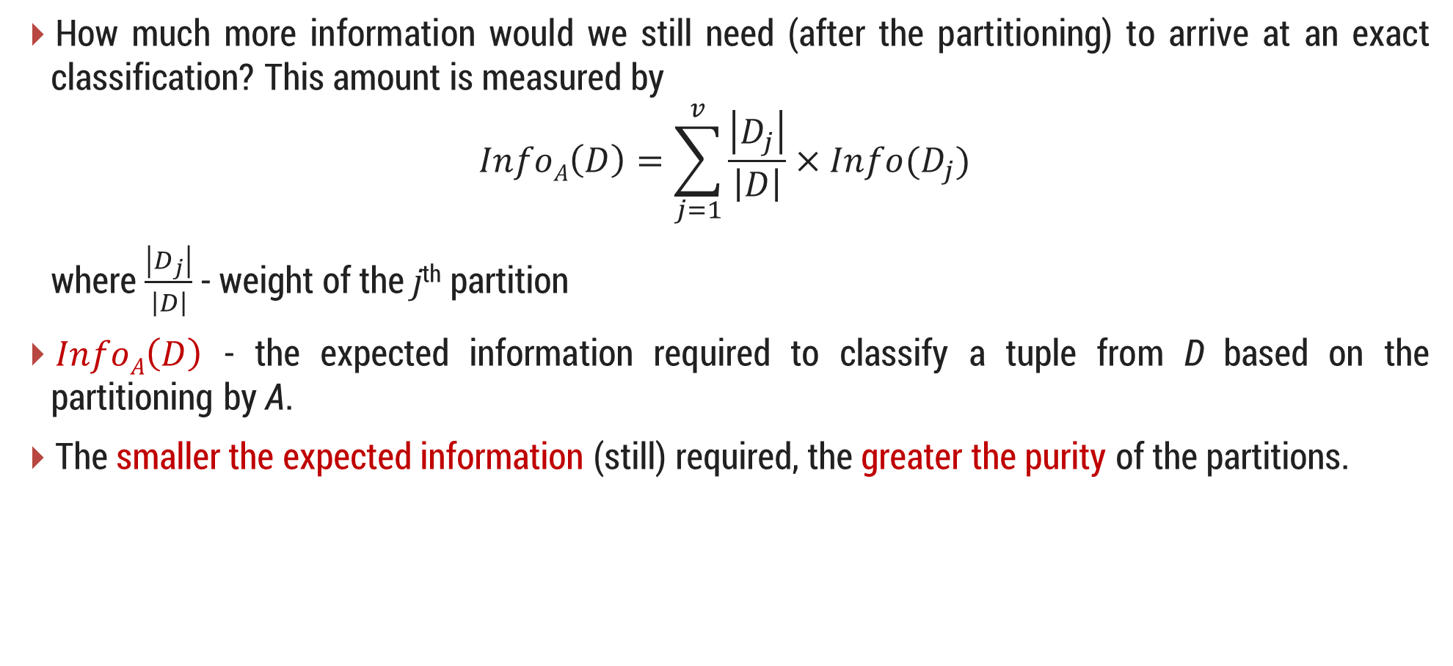
1. Information Gain Cont..
How much more information would we still need (after the partitioning) to arrive at an exact classification? This amount is measured by
$$InfoA\left(D\right)=\sum_{j=1}^{v}{\frac{\left|D_{j}\right|}{\left|D\right|}×Info(D_{j})}$$
where $\frac{\left|D_{j}\right|}{\left|D\right|}$ - weight of the j^{th} partition
$InfoA\left(D\right)$ - the expected information required to classify a tuple from D based on the partitioning by A.
The smaller the expected information (still) required, the greater the purity of the partitions.

Slide 18

1. Information Gain Cont..
Information gain is defined as the difference between the original information requirement (i.e., based on just the proportion of classes) and the new requirement (i.e., obtained after partitioning on A).
$$Gain\left(A\right)=Info\left(D\right)−InfoA(D)$$
The attribute A with the highest information gain is chosen as the splitting attribute at node N.

Slide 19
Information Gain - Example
RID | age | income | student | credit_rating | Class: buys_computer
1 | youth | high | no | fair | no
2 | youth | high | no | excellent | no
3 | middle_aged | high | no | fair | yes
4 | senior | medium | no | fair | yes
5 | senior | low | yes | fair | yes
6 | senior | low | yes | excellent | no
7 | middle_aged | low | yes | excellent | yes
8 | youth | medium | no | fair | no
9 | youth | low | yes | fair | yes
10 | senior | medium | yes | fair | yes
11 | youth | medium | yes | excellent | yes
12 | middle_aged | medium | no | excellent | yes
13 | middle_aged | high | yes | fair | yes
14 | senior | medium | no | excellent | no

Slide 20
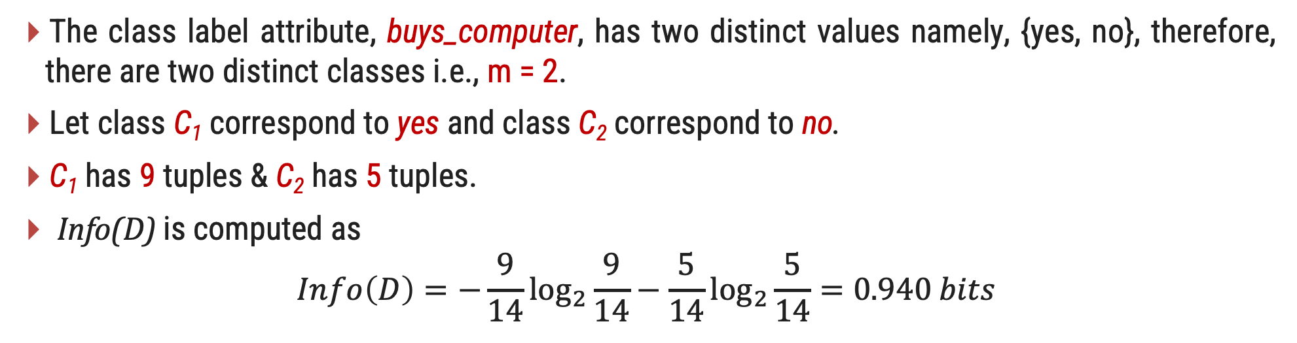
Information Gain - Example
The class label attribute, buys_computer, has two distinct values namely, {yes, no}, therefore, there are two distinct classes i.e., m = 2.
Let class C₁ correspond to yes and class C₂ correspond to no.
C₁ has 9 tuples & C₂ has 5 tuples.
Info(D) is computed as
$$Info\left(D\right)=−\frac{9}{14}\log_{2}{\frac{9}{14}}−\frac{5}{14}\log_{2}{\frac{5}{14}}=0.940 bits$$
Distinct Values | Count
Yes | 9
No | 5
Total | 14

Slide 21
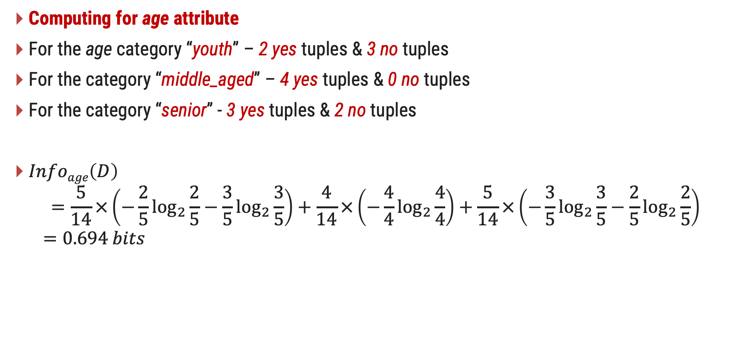
Information Gain - Example
Computing for age attribute
For the age category “youth” – 2 yes tuples & 3 no tuples
For the category “middle_aged” – 4 yes tuples & 0 no tuples
For the category “senior” - 3 yes tuples & 2 no tuples
$Infoage\left(D\right)$
$$=\frac{5}{14}×\left(−\frac{2}{5}\log_{2}{\frac{2}{5}}−\frac{3}{5}\log_{2}{\frac{3}{5}}\right)+\frac{4}{14}×\left(−\frac{4}{4}\log_{2}{\frac{4}{4}}\right)+\frac{5}{14}×\left(−\frac{3}{5}\log_{2}{\frac{3}{5}}−\frac{2}{5}\log_{2}{\frac{2}{5}}\right)$$
$$=0.694 bits$$
Distinct Values | Yes | No | Total
youth | 2 | 3 | 5
middle_aged | 4 | 0 | 4
senior | 3 | 2 | 5
Info(youth)
Info(middle_age)
Info(senior)

Slide 22
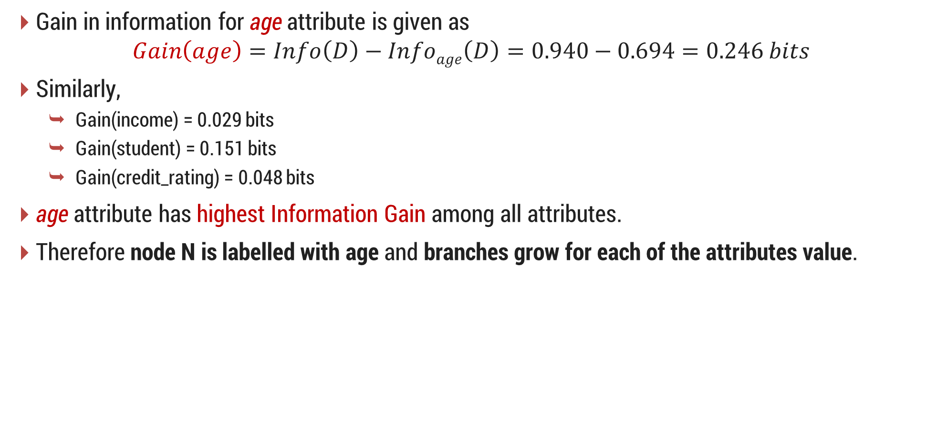
Information Gain - Example
Gain in information for age attribute is given as
$$Gain\left(age\right)=Info\left(D\right)−Infoage\left(D\right)=0.940−0.694=0.246 bits$$
Similarly,
Gain(income) = 0.029 bits
Gain(student) = 0.151 bits
Gain(credit_rating) = 0.048 bits
age attribute has highest Information Gain among all attributes.
Therefore node N is labelled with age and branches grow for each of the attributes value.

Slide 23
Information Gain - Example
Splitting Attribute age at Root node
age?
youth
senior
middle_aged
income | student | credit_rating | class
high | no | fair | no
high | no | excellent | no
medium | no | fair | no
low | yes | fair | yes
medium | yes | excellent | yes
income | student | credit_rating | class
medium | no | fair | yes
low | yes | fair | yes
low | yes | excellent | no
medium | yes | fair | yes
medium | no | excellent | no
income | student | credit_rating | class
high | no | fair | yes
low | yes | excellent | yes
medium | no | excellent | yes
high | yes | fair | yes

Slide 24

2. Gain Ratio
The information gain measure is biased toward tests with many outcomes.
For example, consider an attribute that acts as a unique identifier such as product_ID.
A split on product_ID would result in a large number of partitions each one containing just one tuple.
$Infoproduct_ID\left(D\right)=0$ for product_ID attribute which results in maximum information gain. Clearly, such a partitioning is useless for classification.

Slide 25
2. Gain Ratio Cont..
C4.5 uses an extension to information gain known as gain ratio.
It applies a kind of normalization to information gain using a “split information” value defined with $Info\left(D\right)$ as
$$SplitInfoA\left(D\right)=−\sum_{j=1}^{v}{\frac{\left|D_{j}\right|}{\left|D\right|}×}\log_{2}\left(\frac{\left|D_{j}\right|}{\left|D\right|}\right)$$
This value represents the potential information generated by splitting the training data set, D, into v partitions, corresponding to the v outcomes of a test on attribute A.
Gain Ratio is defined as
$$GainRatio\left(A\right)=\frac{Gain(A)}{SplitInfoA\left(D\right)}$$
The attribute with the maximum gain ratio is selected as the splitting attribute.

Slide 26
2. Gain Ratio - Example
RID | age | income | student | credit_rating | Class: buys_computer
1 | youth | high | no | fair | no
2 | youth | high | no | excellent | no
3 | middle_aged | high | no | fair | yes
4 | senior | medium | no | fair | yes
5 | senior | low | yes | fair | yes
6 | senior | low | yes | excellent | no
7 | middle_aged | low | yes | excellent | yes
8 | youth | medium | no | fair | no
9 | youth | low | yes | fair | yes
10 | senior | medium | yes | fair | yes
11 | youth | medium | yes | excellent | yes
12 | middle_aged | medium | no | excellent | yes
13 | middle_aged | high | yes | fair | yes
14 | senior | medium | no | excellent | no

Slide 27
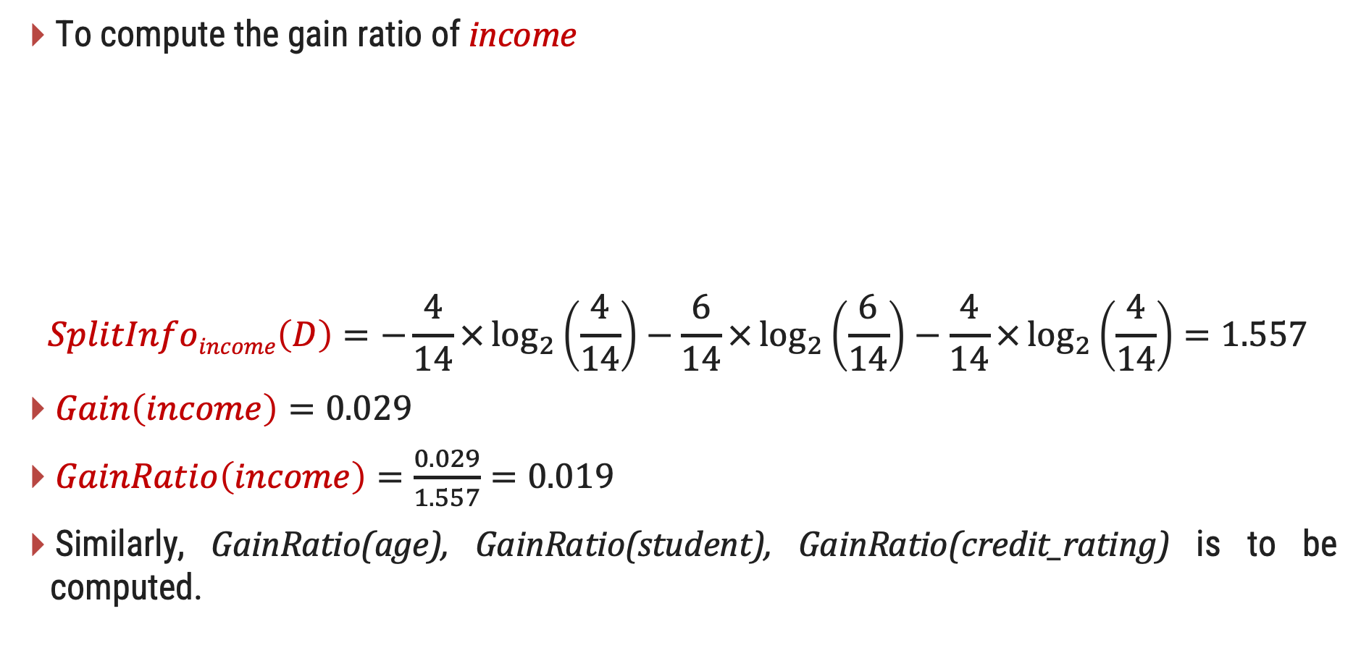
Gain Ratio for the attribute income - Example
To compute the gain ratio of income
$$SplitInfoincome\left(D\right)=−\frac{4}{14}×\log_{2}\left(\frac{4}{14}\right)−\frac{6}{14}×\log_{2}\left(\frac{6}{14}\right)−\frac{4}{14}×\log_{2}\left(\frac{4}{14}\right)=1.557$$
$Gain\left(income\right)=0.029$
$GainRatio\left(income\right)=\frac{0.029}{1.557}=0.019$
Similarly, GainRatio(age), GainRatio(student), GainRatio(credit_rating) is to be computed.
Distinct Values | Total
high | 4
medium | 6
low | 4

Slide 28
3. Gini Index
CART uses Gini Index.
The Gini index measures the impurity of D, a data partition or set of training tuples, as
$$Gini\left(D\right)=1−\sum_{i=1}^{m}{p_{i}^{2}}$$
where $p_{i}$ is the probability that a tuple in D belongs to class $C_{i}$ and is estimated by $\left|C_{i,D}\right|/\left|D\right|$.
The Gini index considers a binary split for each attribute.

Slide 29
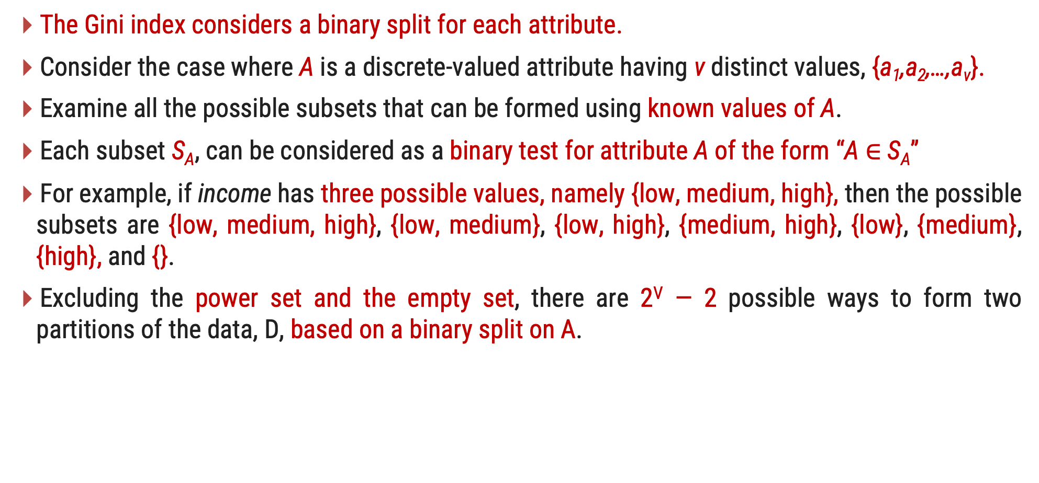
3. Gini Index Cont..
The Gini index considers a binary split for each attribute.
Consider the case where A is a discrete-valued attribute having v distinct values, {a₁,a₂,…,a_{v}}.
Examine all the possible subsets that can be formed using known values of A.
Each subset S_{A}, can be considered as a binary test for attribute A of the form “A $∈$ S_{A}”
For example, if income has three possible values, namely {low, medium, high}, then the possible subsets are {low, medium, high}, {low, medium}, {low, high}, {medium, high}, {low}, {medium}, {high}, and {}.
Excluding the power set and the empty set, there are 2^{V} — 2 possible ways to form two partitions of the data, D, based on a binary split on A.

Slide 30
3. Gini Index Cont..
Compute a weighted sum of the impurity of each resulting partition. For example, if a binary split on A partitions D into D₁ and D₂, the Gini index of D given that partitioning is
$$GiniA\left(D\right)=\frac{\left|D_{1}\right|}{\left|D\right|}Gini\left(D_{1}\right)+\frac{\left|D_{2}\right|}{\left|D\right|}Gini(D_{2})$$
For a discrete-valued attribute, the subset that gives the minimum Gini index for that attribute is selected as its splitting subset.

Slide 31
3. Gini Index - Example
RID | age | income | student | credit_rating | Class: buys_computer
1 | youth | high | no | fair | no
2 | youth | high | no | excellent | no
3 | middle_aged | high | no | fair | yes
4 | senior | medium | no | fair | yes
5 | senior | low | yes | fair | yes
6 | senior | low | yes | excellent | no
7 | middle_aged | low | yes | excellent | yes
8 | youth | medium | no | fair | no
9 | youth | low | yes | fair | yes
10 | senior | medium | yes | fair | yes
11 | youth | medium | yes | excellent | yes
12 | middle_aged | medium | no | excellent | yes
13 | middle_aged | high | yes | fair | yes
14 | senior | medium | no | excellent | no

Slide 32
3. Gini Index – Example Cont..
Considering the data of AllElectronics,
buys_computer = yes - 9 tuples
buys_computer = no - 5 tuples
Gini index to compute the impurity of D is
$$Gini\left(D\right)=1−{\left(\frac{9}{14}\right)}^{2}−{\left(\frac{5}{14}\right)}^{2}=0.459$$

Slide 33
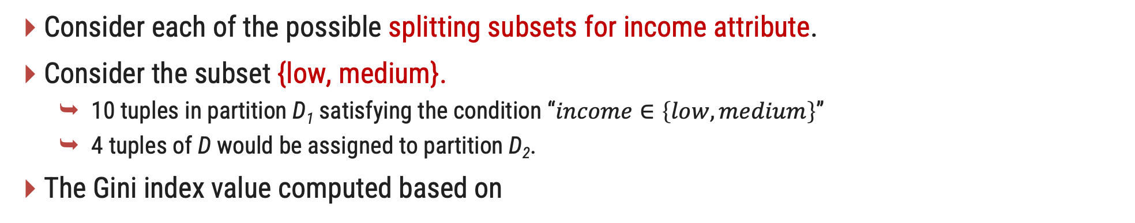
3. Gini Index – Example Cont..
Consider each of the possible splitting subsets for income attribute.
Consider the subset {low, medium}.
10 tuples in partition D₁ satisfying the condition “$income∈\left\{low,medium\right\}$”
4 tuples of D would be assigned to partition D₂.
The Gini index value computed based on
$$=\frac{10}{14}Gini\left(D1\right)+\frac{4}{14}Gini(D2)$$
$${Gini}_{income∈\left\{low,medium\right\}}\left(D\right)$$
$$=\frac{10}{14}\left(1−{\left(\frac{7}{10}\right)}^{2}−{\left(\frac{3}{10}\right)}^{2}\right)+\frac{4}{14}\left(1−{\left(\frac{2}{4}\right)}^{2}−{\left(\frac{2}{4}\right)}^{2}\right)$$
Distinct Values | Yes | No | Total
Low, Medium | 7 | 3 | 10
High | 2 | 2 | 4
$$=0.443$$
$$={Gini}_{income∈\left\{high\right\}}\left(D\right)$$

Slide 34


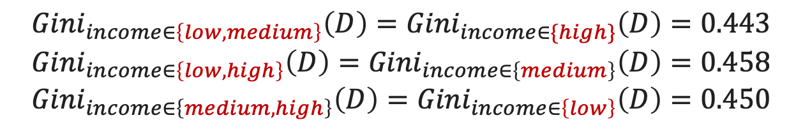

3. Gini Index – Example Cont..
$${Gini}_{income∈\left\{low,medium\right\}}\left(D\right)={Gini}_{income∈\{high\}}\left(D\right)=0.443$$
$${Gini}_{income∈\left\{low,high\right\}}\left(D\right)={Gini}_{income∈\left\{medium\right\}}\left(D\right)=0.458$$
$${Gini}_{income∈\left\{medium,high\right\}}\left(D\right)={Gini}_{income∈\left\{low\right\}}\left(D\right)=0.450$$
Income
Age
$${Gini}_{age∈\left\{youth,senior\right\}}\left(D\right)={Gini}_{age∈\left\{middle_aged\right\}}\left(D\right)=0.357$$
Student
$${Gini}_{student∈\left\{yes,no\right\}}\left(D\right)=0.367$$
Credit
Rating
$${Gini}_{credit_rating∈\left\{fair,excellent\right\}}\left(D\right)=0.429$$

Slide 35
Tree Pruning
When a decision tree is built, many of the branches will reflect anomalies in the training data due to noise or outliers.
We can remove the least-reliable branches from the tree.
There are two common approaches to tree pruning: prepruning and postpruning.
Prepruning:
A tree is “pruned” by halting its construction early (e.g., by deciding not to further split or partition the subset of training tuples at a given node).
If partitioning the tuples at a node would result in a split that falls below a prespecified threshold, then further partitioning of the given subset is halted.
There are difficulties, however, in choosing an appropriate threshold. High thresholds could result in oversimplified trees, whereas low thresholds could result in very little simplification.

Slide 36
Tree Pruning
Postpruning:
Which removes subtrees from a “fully grown” tree.
A subtree at a given node is pruned by removing its branches and replacing it with a leaf.
The leaf is labeled with the most frequent class among the subtree being replaced.
A1
A1
Yes
No
No
Yes
A2
A3
No
A2
Yes
No
Yes
No
Yes
No
A4
Yes
A5
No
A4
Yes
Yes
No
Yes
No
Yes
No
Yes
No
No
Yes
Yes
No

Slide 37
Tree Pruning
Cost complexity pruning algorithm:
It is used in CART
This method considers two factors: the number of leaves in the tree(cost complexity) and the error rate (misclassification percentage).
For each inner node N:
Calculate the cost complexity of the subtree rooted at N.
Calculate the cost complexity if the subtree at N were replaced by a leaf node.
Compare these two cost complexity values.
If pruning N's subtree leads to lower cost complexity, prune the subtree (replace it with a leaf node). Otherwise, keep it intact.

Slide 38
Bayesian Classification
The Naive Bayes classifier works on the principle of conditional probability, as given by the Bayes theorem.
They can predict class membership probabilities such as the probability that a given tuple belongs to a particular class.

Slide 39
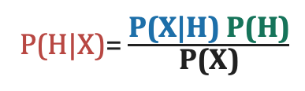
Bayes’ Theorem
Bayesian classification is used to find conditional probabilities.
Consider a data set D with a tuple X in Bayes Theorem X works as an evidence.
P(H|X) :
The probability of customer X purchasing a computer, considering the information about the customer's age and income.
Here H conditioned on X.
The Bayes Theorem:
P(H|X)= $\frac{\text{P}\text{(}\text{X}\text{|}\text{H}\text{) }\text{P}\text{(}\text{H}\text{)}}{\text{P}\text{(}\text{X}\text{)}}$
Let H be some hypothesis such as that the data tuple X belongs to a specified class C.
X is a customer with age 35 and income 40,000 Rs.

Slide 40
Bayes’ Theorem
P(X|H) :
The probability that customer X is 35 years old and earns 40,000 Rs., given that we are aware that he/she intends to purchase the computer.
Here X conditioned on H.
P(H) :
The probability that the customer will buy the computer.
P(X) :
The probability the customer X from a set of customers is 35 years old and earns 40,000 Rs.
Here P(H|X), P(X|H) are called as posterior probability and P(X) ,P(H) are called prior probability.
The Bayes Theorem:
P(H|X)= $\frac{\text{P}\text{(}\text{X}\text{|}\text{H}\text{) }\text{P}\text{(}\text{H}\text{)}}{\text{P}\text{(}\text{X}\text{)}}$

Slide 41
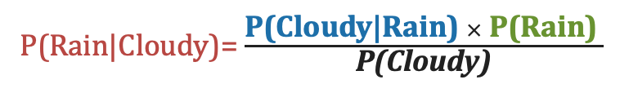
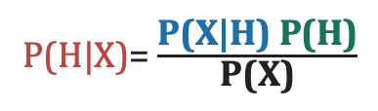
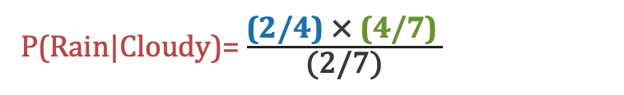
Example
Day | Weather | Rain
1 | Sunny | No
2 | Rainy | Yes
3 | Cloudy | Yes
4 | Sunny | No
5 | Rainy | Yes
6 | Sunny | No
7 | Cloudy | Yes
The Bayes Theorem:
To find the probability of rain given that it's cloudy (P(Rain|Cloudy))
P(H|X)= $\frac{\text{P}\text{(}\text{X}\text{|}\text{H}\text{) }\text{P}\text{(}\text{H}\text{)}}{\text{P}\text{(}\text{X}\text{)}}$
P(Rain|Cloudy)= $\frac{\text{P}\text{(}\text{Cloudy}\text{|}\text{Rain}\text{) }× \text{P}\text{(}\text{Rain}\text{)} }{\text{P}\text{(}\text{Cloudy}\text{)}}$
P(Rain|Cloudy)= $\frac{\text{(2/}\text{4}\text{) }\text{×} \text{(4/7)} }{\text{(2/7)}}$
P(Rain|Cloudy)=1
the probability of rain given that it's cloudy is approximately 100%
X
H

Slide 42
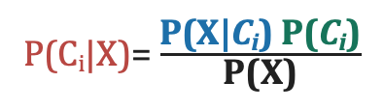
Naive Bayesian Classification : Steps
The naive Bayesian classifier, or simple Bayesian classifier, works as follows:
Step:1
Let D be a training set of tuples and their associated class labels, and each tuple is represented by an n-D attribute vector X = (x1, x2, …, xn)
Step:2
Suppose there are m classes C1, C2, …, Cm.
Given a tuple, X, the classifier will predict that X belongs to the class having the highest posterior probability, conditioned on X.
We find maximum P(C_{i}|X).
This can be derived from Bayes’ theorem
P(C_{i}|X)= $\frac{\text{P}\text{(}\text{X}\text{|}\text{C}\text{i}\text{) }\text{P}\text{(}\text{C}\text{i}\text{)}}{\text{P}\text{(}\text{X}\text{)}}$

Slide 43
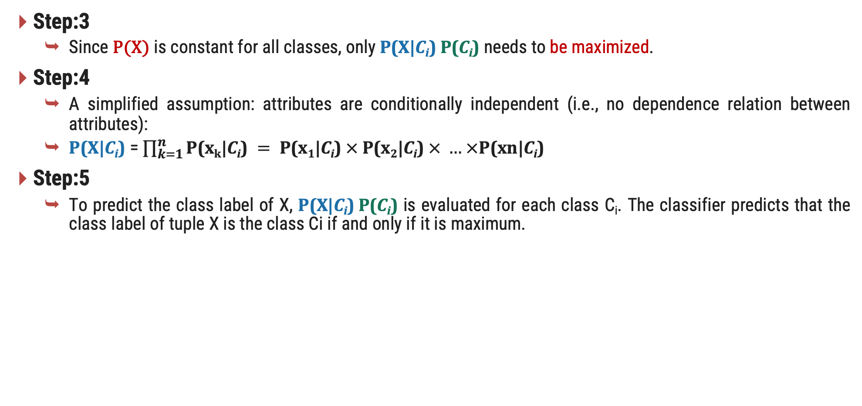
Naive Bayesian Classification : Steps
Step:3
Since P(X) is constant for all classes, only $\text{P}\text{(}\text{X}\text{|}\text{C}\text{i}\text{) }\text{P}\text{(}\text{C}\text{i}\text{)}$ needs to be maximized.
Step:4
A simplified assumption: attributes are conditionally independent (i.e., no dependence relation between attributes):
$\text{P}\text{(}\text{X}\text{|}\text{C}\text{i}\text{)}$ = $\prod_{k=1}^{n}{\text{P}\text{(}\text{x}\text{k}\text{|}\text{C}\text{i}\text{)} = \text{P}\text{(}\text{x}\text{1}\text{|}\text{C}\text{i}\text{)} × \text{P}\text{(}\text{x}\text{2}\text{|}\text{C}\text{i}\text{)} × … ×\text{P}\text{(}\text{xn}\text{|}\text{C}\text{i}\text{)}}$
Step:5
To predict the class label of X, $\text{P}\text{(}\text{X}\text{|}\text{C}\text{i}\text{) }\text{P}\text{(}\text{C}\text{i}\text{)}$ is evaluated for each class C_{i}. The classifier predicts that the class label of tuple X is the class Ci if and only if it is maximum.

Slide 44
Naive Bayesian : Example
Day | Outlook | Temperature | Humidity | Wind | PlayTennis
1 | Sunny | Hot | High | Weak | No
2 | Sunny | Hot | High | Strong | No
3 | Overcast | Hot | High | Weak | Yes
4 | Rain | Mild | High | Weak | Yes
5 | Rain | Cool | Normal | Weak | Yes
6 | Rain | Cool | Normal | Strong | No
7 | Overcast | Cool | Normal | Strong | Yes
8 | Sunny | Mild | High | Weak | No
9 | Sunny | Cool | Normal | Weak | Yes
10 | Rain | Mild | Normal | Weak | Yes
11 | Sunny | Mild | Normal | Strong | Yes
12 | Overcast | Mild | High | Strong | Yes
13 | Overcast | Hot | Normal | Weak | Yes
14 | Rain | Mild | High | Strong | No
Given a new instance,
x’=(Outlook=Sunny, Temperature=Cool, Humidity=High, Wind=Strong)
P(Play=Yes) = 9/14
P(Play=No) = 5/14

Slide 45
Naive Bayesian : Example
Outlook | Yes | No
Sunny | 2/9 | 3/5
Overcast | 4/9 | 0/5
Rain | 3/9 | 2/5
Temp. | Yes | No
Hot | 2/9 | 2/5
Mild | 4/9 | 2/5
Cool | 3/9 | 1/5
Humidity | Yes | No
High | 3/9 | 4/5
Normal | 6/9 | 1/5
Wind | Yes | No
Strong | 3/9 | 3/5
Weak | 6/9 | 2/5
x’=(Outlook=Sunny, Temperature=Cool, Humidity=High, Wind=Strong) = ?
P(C_{i}|X) = $\text{P}\text{(}\text{x}\text{1}\text{|}\text{C}\text{i}\text{)} \text{× }\text{P}\text{(}\text{x}\text{2}\text{|}\text{C}\text{i}\text{) }\text{× … ×}\text{P}\text{(}\text{xn}\text{|}\text{C}\text{i}\text{) }\text{×} \text{P}\text{(}\text{C}\text{i}\text{)}$
P(Yes|x’) = [P(Sunny|Yes) * P(Cool|Yes) * P(High|Yes)* P(Strong|Yes)] * P(Play=Yes)
= [2/9 * 3/9 * 3/9 * 3/9 ] * 9/14 = 0.0053
P(No|x’) = [P(Sunny|No) * P(Cool|No) * P(High|No) * P(Strong|No)] * P(Play=No)
= [3/5 * 1/5 * 4/5 * 3/5 ] * 5/14 = 0.0206
we label x’ to be “No”.

Slide 46
Rule-Based Classification
Rules are a good way of representing information or bits of knowledge.
A rule-based classifier uses a set of IF-THEN rules for classification.
An IF-THEN rule is an expression of the form
IF condition THEN conclusion.
IF age = youth AND student = yes THEN buys_computer = yes.
The “IF” part (or left side) of a rule is known as the rule antecedent or precondition.
The “THEN” part (or right side) is the rule consequent.

Slide 47
Rule-Based Classification
In the rule antecedent, the condition consists of one or more attribute tests (e.g., age = youth and student = yes) that are logically ANDed.
The rule’s consequent contains a class prediction
If the condition (i.e., all the attribute tests) in a rule antecedent holds true for a given tuple, we say that the rule antecedent is satisfied and that the rule covers the tuple.

Slide 48
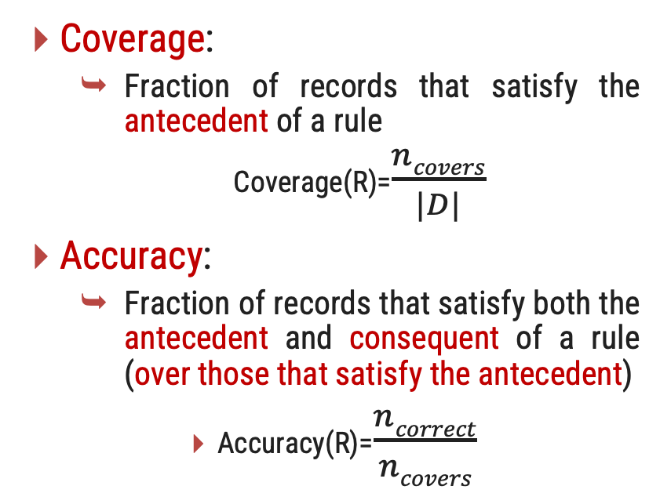
Coverage and Accuracy
Coverage:
Fraction of records that satisfy the antecedent of a rule
Coverage(R)=$\frac{ncovers}{|D|}$
Accuracy:
Fraction of records that satisfy both the antecedent and consequent of a rule (over those that satisfy the antecedent)
Accuracy(R)=$\frac{ncorrect}{ncovers}$
Day | Outlook | Wind | PlayTennis
1 | Sunny | Weak | Yes
2 | Sunny | Strong | No
3 | Overcast | Weak | Yes
4 | Rain | Weak | Yes
5 | Rain | Weak | Yes
6 | Rain | Strong | No
7 | Overcast | Strong | Yes
8 | Sunny | Weak | No
9 | Sunny | Weak | Yes
10 | Rain | Weak | Yes
$ncovers$ = No. of records that satisfy the antecedent of a rule
R = (Outlook=Sunny) → PlayTennis=Yes
Coverage = 4/10 = 40%
Accuracy = 2/4 = 50%
|D| = No. of records in D
$ncorrect$ = No. of records that correctly classified by R

Slide 49
Resolution Strategy
X= (age = youth, income = medium, student = yes, credit rating = fair) ?.
We would like to classify X according to buys computer. X satisfies R1, which triggers the rule.
A tuple X may satisfied more then rules simultaneously.
This can lead to a challenge when faced with conflicting class predictions from different triggered rules or when no rule is satisfied for X.
Two strategy are available namely Size ordering and Rule ordering.
Size Ordering:
In the size ordering strategy, rules are assigned a priority based on their complexity.
The rule with the most conditions or the most specific conditions is given higher priority.
When conflicts arise, the rule with higher complexity or specificity takes precedence and determines the class prediction.

Slide 50
Resolution Strategy
Rule ordering:
Class-Based Ordering:
The classes are sorted in order of decreasing “importance”
All the rules for the most prevalent (or most frequent) class come first, the rules for the next prevalent class come next, and so on.
Within each class, the rules are not ordered they don’t have to be because they all predict the same class
Rule-based ordering
The rules are organized into one long priority list, according to some measure of rule quality, such as accuracy, coverage, or size (number of attribute tests in the rule antecedent)
Rule that appears earliest in the list has the highest priority, and so it gets to fire its class prediction. Any other rule that satisfies X is ignored.

Slide 51
Resolution Strategy
Consider a scenario where there is no rule satisfied by X
How to determine the class label of X?
In this case, a fallback or default rule can be set up to specify a default class, based on a training set.
The default rule is evaluated at the end, if and only if no other rule covers X.
The condition in the default rule is empty. In this way, the rule fires when no other rule is satisfied.

Slide 52
Rule Extraction from a Decision Tree
It convert tree into set of rules.
One rule for each leaf.
Antecedent contains a condition for every node on the path from the root to the leaf.
Straightforward, but rule set might be overly complex.
Each splitting criterion along a given path is logically ANDed to form the rule antecedent (“IF” part).
The leaf node holds the class prediction, forming the rule consequent (“THEN” part).

Slide 53
Rule Extraction from a Decision Tree
age?
youth
senior
middle_aged
student?
Yes
credit_rating?
no
yes
fair
excellent
No
yes
No
Yes
R1: IF age = youth AND student = no R2: IF age = youth AND student = yes R3: IF age = middle aged
R4: IF age = senior AND credit rating = excellent R5: IF age = senior AND credit rating = fair
THEN buys_computer = no
THEN buys_computer = yes
THEN buys_computer = yes
THEN buys_computer = yes
THEN buys_computer = no

Slide 54
Rule Extraction from a Decision Tree
Rules are directly extracted from tree they are mutually exclusive and exhaustive.
Mutually exclusive rules:
No two rules are triggered by the same record.
This ensures that every record is covered by at most one rule.
Exhaustive rules
There exists a rule for each combination of attribute values.
This ensures that every record is covered by at least one rule.
Together these properties ensure that every record is covered by exactly one rule.

Slide 55
Rule Induction Using a Sequential Covering Algorithm
IF-THEN rules can be extracted directly from the training data (i.e., without having to generate a decision tree first) using a sequential covering algorithm.
The name comes from the notion that the rules are learned sequentially (one at a time),
here are many sequential covering algorithms. Popular variations include AQ, CN2, and the more recent RIPPER.
The general strategy is as follows.
Rules are learned one at a time.
Each time a rule is learned, the tuples covered by the rule are removed, and
The process repeats on the remaining tuples.

Slide 56
Algorithm: Sequential covering
INPUT:
D, a data set of class-labeled tuples; Att_vals, the set of all attributes and their possible values.
Output:
A set of IF-THEN rules.
Rule_set = {}; // initial set of rules learned is empty
for each class c do
repeat Rule = Learn_One_Rule(D, Att_vals, c); remove tuples covered by Rule from D; Rule_set = Rule_set + Rule; // add new rule to rule set
until terminating condition;
endfor
return Rule Set;

Slide 57
Algorithm: Sequential covering
The process continues until the terminating condition is met, such as when there are no more training tuples or the quality of a rule returned is below a user-specified threshold.
The Learn One Rule procedure finds the “best” rule for the current class, given the current set of training tuples.
How are rules learned?
Typically, rules are grown in a general-to-specific manner. We can think of this as a beam search.
where we start off with an empty rule and then gradually keep appending attribute tests to it.
The classifying attribute is loan decision, which indicates whether a loan is accepted (considered safe) or rejected (considered risky).
To learn a rule for the class “accept,”
we start off with the most general rule possible, that is, the condition of the rule antecedent is empty. The rule is:
IF _ THEN loan decision = accept

Slide 58
Algorithm: Sequential covering
IF _ THEN loan_decision = accept
IF income = high THEN loan_decision = accept
IF income = medium THEN loan_decision = accept
….
IF loan_term = short THEN loan_decision = accept
F loan_term = long THEN loan_decision = accept
….
….
IF income = high AND credit_rating = excellent THEN loan_decision = accept
….
….

Slide 59
Algorithm: Sequential covering
Learn One Rule adopts a greedy depth-first strategy.
Each time it is faced with adding a new attribute test (conjunct) to the current rule.
it picks the one that most improves the rule quality, based on the training samples.
Greedy search does not allow for backtracking.
At each step, we heuristically add what appears to be the best choice at the moment.

Slide 60
Model Evaluation and Selection
Now that you may have built a classification model, there may be many questions going through your mind.
For example, suppose you used data from previous sales to build a classifier to predict customer purchasing behavior.
You would like an estimate of how accurately the classifier can predict the purchasing behavior of future customers, that is, future customer data on which the classifier has not been trained.
You may even have tried different methods to build more than one classifier and now wish to compare their accuracy.
Derive
model
Estimate
accuracy
Training
Set
Data
Test
Set

Slide 61
Metrics for Performance Evaluation: Confusion Matrix
Actual\ predicted | Yes | No
Yes | TP | FN
No | FP | TN
TP :True Positive
FN :False Negative
FP : False Positive
TN : True Negative
True Positive: These refer to the positive tuples that were correctly labeled by the classifier.
True negatives: These are the negative tuples that were correctly labeled by the classifier.
False positives: These are the negative tuples that were incorrectly labeled as positive.
False negatives: These are the positive tuples that were mislabeled as negative.

Slide 62
Metrics for Performance Evaluation: Confusion Matrix
Patient | BP | BMI | Diabetes
1 | 120 | 25.5 | No
2 | 130 | 30.1 | Yes
3 | 110 | 22.8 | No
4 | 140 | 28.7 | Yes
5 | 125 | 24.0 | No
6 | 118 | 26.3 | No
7 | 135 | 31.2 | Yes
8 | 128 | 27.5 | Yes
9 | 130 | 23.8 | No
10 | 122 | 29.6 | Yes
11 | 115 | 24.9 | No
12 | 142 | 32.0 | Yes
13 | 127 | 26.7 | No
14 | 138 | 30.5 | Yes
Actual\ predicted | Yes | No
Yes | TP | FN
No | FP | TN
Tanning Data Set
Model
Predicated by
Model
Actual\ predicted | Yes | No
Yes | 2 | 2
No | 1 | 2
Testing
Yes
Yes
Yes
No
No
No
No

Slide 63
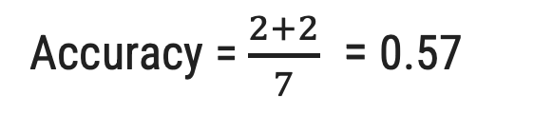
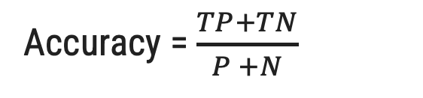
Accuracy(Recognition rate)
The accuracy of a classifier on a given test set is the percentage of test set tuples that are correctly classified by the classifier.
Actual\ predicted | Yes | No
Yes | TP | FN
No | FP | TN
Total
Accuracy = $\frac{TP+TN}{P +N}$
P
N
Actual\ predicted | Yes | No
Yes | 2 | 2
No | 1 | 2
Total
Accuracy = $\frac{2+2}{7}$ = 0.57
4
3

Slide 64
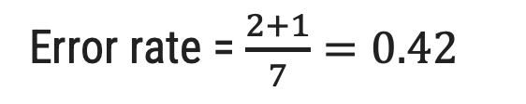
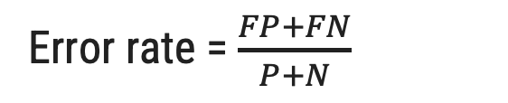
Error rate (Misclassification rate)
Error rate or misclassification rate of a classifier M, is simply 1−accuracy(M), where accuracy(M) is the accuracy of M. This also can be computed as
Actual\ predicted | Yes | No
Yes | TP | FN
No | FP | TN
Total
Error rate = $\frac{FP+FN}{P+N}$
P
N
Actual\ predicted | Yes | No
Yes | 2 | 2
No | 1 | 2
Total
Error rate = $\frac{2+1}{7}=0.42$
4
3

Slide 65
Class imbalance problem
where the main class of interest is rare.
In medical data, there may be a rare class, such as “cancer.”
Suppose that you have trained a classifier to classify medical data tuples, where the class label attribute is “cancer” and the possible class values are “yes” and “no.”
An accuracy rate of, say, 97% may make the classifier seem quite accurate, but what if only, say, 3% of the training tuples are actually cancer? Clearly, an accuracy rate of 97% may not be acceptable.
Sensitivity (the proportion of positive tuples that are correctly identified) = $\frac{TP}{P}$
specificity (the proportion of negative tuples that are correctly identified ) =$\frac{FP}{F}$
Accuracy = Sensitivity $\frac{P}{P+N}$ + specificity$\frac{N}{P+N}$

Slide 66
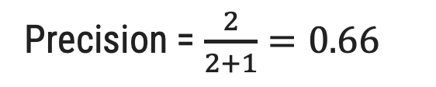
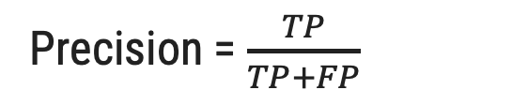
Precision
Exactness – what % of tuples that the classifier labeled as positive are actually positive.
It calculates the ratio of correctly predicted positive instances to the total number of instances predicted as positive.
Actual\ predicted | Yes | No
Yes | TP | FN
No | FP | TN
Total
P
Precision = $\frac{TP}{TP+FP}$
N
Actual\ predicted | Yes | No
Yes | 2 | 2
No | 1 | 2
Total
Precision = $\frac{2}{2+1}=0.66$
4
3

Slide 67
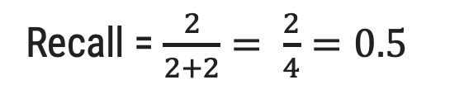
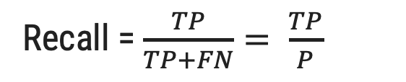
Recall
Completeness – what % of positive tuples did the classifier label as positive?
It calculates the ratio of true positives to the total number of actual positive instances.
Actual\ predicted | Yes | No
Yes | TP | FN
No | FP | TN
Total
Recall = $\frac{TP}{TP+FN}= \frac{TP}{P}$
P
N
Actual\ predicted | Yes | No
Yes | 2 | 2
No | 1 | 2
Total
Recall = $\frac{2}{2+2}= \frac{2}{4}=0.5$
4
3

Slide 68
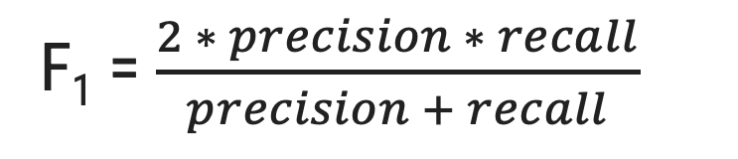
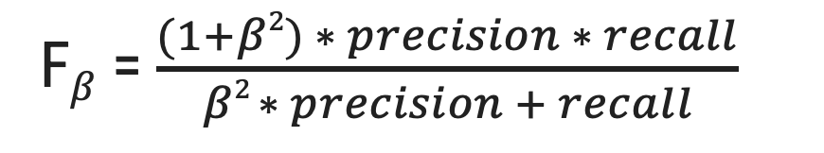
F₁ and F$β$ Measure
F measure also known as the F₁ score or F-score. it is harmonic mean of precision and recall.
It provides a balanced assessment of a model's performance by taking both false positives and false negatives into account.
The F1-score ranges between 0 (worst) and 1 (best).
The F_{β} measure is a weighted measure of precision and recall.
where β is a non-negative real number.
It allow you to control the emphasis on precision or recall using the parameter β. When β > 1, it emphasizes recall more than precision, and when 0 < β < 1, it emphasizes precision more than recall.
F$β$ = $\frac{(1+β2) ∗ precision ∗ recall}{β2 ∗ precision + recall}$
F₁ = $\frac{2 ∗ precision ∗ recall}{precision + recall}$

Slide 69
Evaluating Classifier Accuracy: Holdout
Holdout method:
Given data is randomly partitioned into two independent sets
Training set (e.g., 2/3) for model construction
Test set (e.g., 1/3) for accuracy estimation
Random sampling:
A variation of holdout
Repeat holdout k times, accuracy = avg. of the accuracies obtained
Derive
model
Estimate
accuracy
Training
Set
Data
Test
Set

Slide 70
Evaluating Classifier Accuracy: Cross-Validation Methods
Cross-validation:
Also know as k fold, where k is 10 recommend.
Randomly partition the data into k mutually exclusive subsets, each approximately equal size
Training and testing is performed k times.
At i-th iteration, use Di as test set and others as training set
That is, in the first iteration, subsets D2,..., Dk collectively serve as the training set to obtain a first model, which is tested on D1

Slide 71
Evaluating Classifier Accuracy: Cross-Validation Methods
Data
K = 10
1
2
3
4
5
6
7
8
9
10
Iteration
Training and testing is performed k times.
1
Test
Train
Train
Train
Train
Train
Train
Train
Train
Train
2
Train
Test
Train
Train
Train
Train
Train
Train
Train
Train
…
10
Train
Train
Train
Train
Train
Train
Train
Train
Train
Test

Slide 72
Evaluating Classifier Accuracy: Bootstrap
Bootstrap:
The bootstrap method samples the given training tuples uniformly with replacement.
That is, each time a tuple is selected, it is equally likely to be selected again and re-added to the training set.
There are several bootstrap methods. A commonly used one is the .632 bootstrap, which works as follows
A data set with d tuples is sampled d times, with replacement, resulting in a training set of d samples.
The data tuples that did not make it into the training set end up forming the test set.
About 63.2% of the original data end up in the bootstrap, and the remaining 36.8% form the test set (since (1 – 1/d)d ≈ e-1 = 0.368)

Slide 73
Comparing Classifiers Based on ROC Curves
Receiver operating characteristic curves are a useful visual tool for comparing two classification models.
ROC curves come from signal detection theory that was developed during World War II for the analysis of radar images.
An ROC curve for a given model shows the trade-off between the true positive rate (TPR) and the false positive rate (FPR).
The area under the ROC curve is a measure of the accuracy of the model.
Any increase in TPR occurs at the cost of an increase in FPR.
Sensitivity (the proportion of positive tuples that are correctly identified) (TPR) = $\frac{TP}{P}$
specificity (the proportion of negative tuples that are correctly identified ) (FPR) = $\frac{FP}{F}$

Slide 74
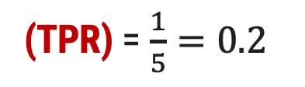
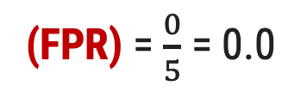
Comparing Classifiers Based on ROC Curves
Tuple | Class | Prob. | TP | FP | TPR | FPR
1 | P | 0.90 | 1 | 0 | 0.2 | 0.0
2 | P | 0.80 | 2 | 0 | 0.4 | 0.0
3 | N | 0.70 | 2 | 1 | 0.4 | 0.2
4 | P | 0.60 | 3 | 1 | 0.6 | 0.2
5 | P | 0.55 | 4 | 1 | 0.8 | 0.2
6 | N | 0.54 | 4 | 2 | 0.8 | 0.4
7 | N | 0.53 | 4 | 3 | 0.8 | 0.6
8 | N | 0.51 | 4 | 4 | 0.8 | 0.8
9 | P | 0.50 | 5 | 4 | 1.0 | 0.8
10 | N | 0.40 | 5 | 5 | 1.0 | 1.0
(TPR) = $\frac{1}{5}=0.2$
Returned by a probabilistic classifier for each of the 10 tuples in a test set, sorted by decreasing probability order.
Vertical axis represents the true positive rate
Horizontal axis represents the false positive rate
A model with perfect accuracy will have an area of 1.0
(FPR) = $\frac{0}{5}$ = 0.0

Slide 75
Techniques to Improve Classification Accuracy
We focus on ensemble methods for improvement of classification accuracy.
It involve combining the predictions from multiple individual models (classifiers) to improve the overall performance.
The individual classifiers vote, and a class label prediction is returned by the ensemble based on the collection of votes.
Combine a series of k learned models, M₁, M₂, …, M_{k}, with the aim of creating an improved model M*
C₁
New Data
Sample
C₂
Combine
Vote
Class
Predication
Data
.
.
C_{T}

Slide 76
Bagging
Analogy: Diagnosis based on multiple doctors’ majority vote.
Training:
Given a set D of d tuples, at each iteration i, a training set D_{i} of d tuples is sampled with replacement from D (i.e., bootstrap)
A classifier model M_{i} is learned for each training set D_{i}
Classification: classify an unknown sample X
Each classifier M_{i} returns its class prediction
The bagged classifier M* counts the votes and assigns the class with the most votes to X
Prediction can be applied to the prediction of continuous values by taking the average value of each prediction for a given test tuple.

Slide 77
Boosting
Analogy: Consult several doctors, based on a combination of weighted diagnoses—weight assigned based on the previous diagnosis accuracy.
How boosting works?
Weights are assigned to each training tuple.
A series of k classifiers is iteratively learned.
After a classifier M_{i} is learned, the weights are updated to allow the subsequent classifier, M_{i+1}, to pay more attention to the training tuples that were misclassified by M_{i}.
The final M* combines the votes of each individual classifier, where the weight of each classifier's vote is a function of its accuracy.
Boosting algorithm can be extended for numeric prediction
Comparing with bagging: Boosting tends to have greater accuracy, but it also risks overfitting the model to misclassified data.

Slide 78
Random Forest
Random Forest:
Each classifier in the ensemble is a decision tree classifier and is generated using a random selection of attributes at each node to determine the split
During classification, each tree votes and the most popular class is returned
Two Methods to construct Random Forest:
Forest-RI (random input selection): Randomly select, at each node, F attributes as candidates for the split at the node. The CART methodology is used to grow the trees to maximum size
Forest-RC (random linear combinations): Creates new attributes (or features) that are a linear combination of the existing attributes (reduces the correlation between individual classifiers)

